Slide 1
Sync Await Promises and Callbacks in JavaScript

Slide 2
Synchronous Vs Asynchronous
Synchronous means to execute in sequence. There should be do wait to start next task till previous task end.
For example, if waiter place an order to cook and waits for preparing order then deliver order to customer then he take further orders from other customers.
Asynchronous means execute parallel. Didn't wait for some process to start a new one.
For example untill order is being cooked by chef, waiter is taking further order from other tables.

Slide 3
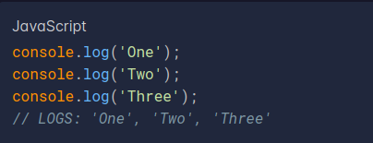
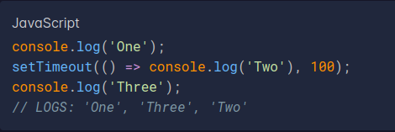
How to make Asynchronous code
Synchronous
Asynchronous
JavaScript code is synchronous by default
You can also use "async" keyword in start of function to make function asynchronous
async function myFunction() { alert('') }

Slide 4
Why are Promises better than Callbacks describing each thoroughly
Callbacks are functions passed to another function as a arguments. Callbacks is good for single callback
Promises are also used for callbacks.
If you want multiple nested callbacks then callbacks function get messy and unreadable
Promises handle multiple callbacks easily and code will be readable

Slide 5
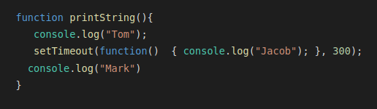
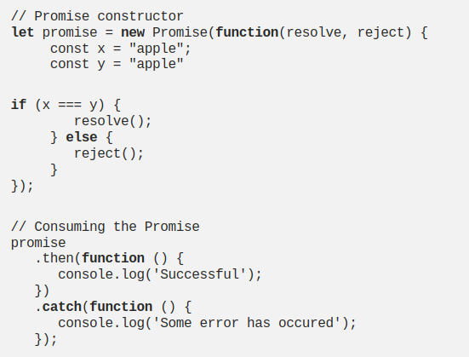
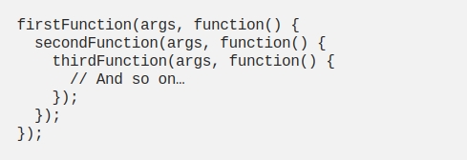
Callbacks
Promises
With multiple nested callback functions are described below
Multiple nested callbacks implemented with Promises

Slide 6
Use of async/await over Promises
Async allow callbacks and promises to be converted into seemingly synchronous code that performs asynchronously.
The code is written in a synchronous way and there is no chaining, as was the case with callbacks and promises.
Async functions not only allow the programmer to escape from callback hell and promise chaining in asynchronous code, but they also make the code seemingly synchronous

Slide 7
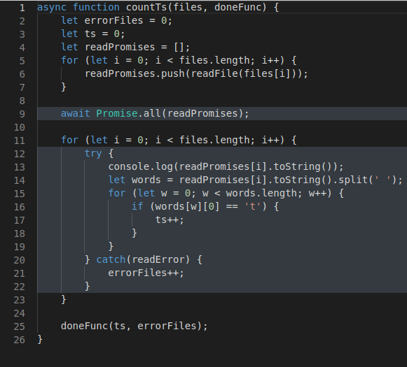
Use of async/await over Promises

